Slide 1
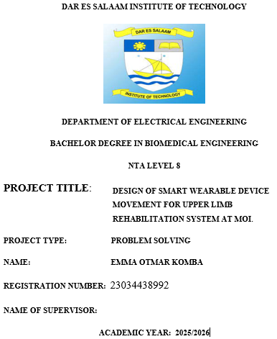

Slide 2
Introduction & Background
Upper limb impairment caused by stroke, injury, neurological disorders
Traditional rehabilitation requires constant therapist supervision
Lack of real-time feedback reduces rehabilitation effectiveness
Smart wearable technology can improve outcomes
Problem Statement
Upper limb rehabilitation is essential for stroke and injury patients
Conventional physiotherapy requires continuous manual supervision
Lack of real-time feedback leads to incorrect movements
High therapist workload and slow recovery
Gap: Absence of affordable smart wearable rehabilitation systems at MOI
Need: A smart wearable system with motor assistance and visual feedback

Slide 3
Main Objective
The main objective is to design a smart wearable device movement for an upper limb rehabilitation
system at Muhimbili Orthopedic Institute (MOI)
Specific Objectives
To design a control circuit for regulating motor- assisted upper limb movement..
To develop a monitoring and feedback system that assist patients and therapist
To build and test a functional prototype of the wearable rehabilitation system .
Significance of the Project
• Improved rehabilitation outcomes
• Increased patient independence
• Enhanced accessibility of rehabilitation services
• Reduced rehabilitation time and cost

Slide 4
Methodology
Literature review
System design
Hardware implementation
Software development
Testing and evaluation
Documentation
Conventional physiotherapy systems
Technology-assisted rehabilitation systems
Limitations of existing systems
Need for wearable and affordable solutions
Literature Review

Slide 5
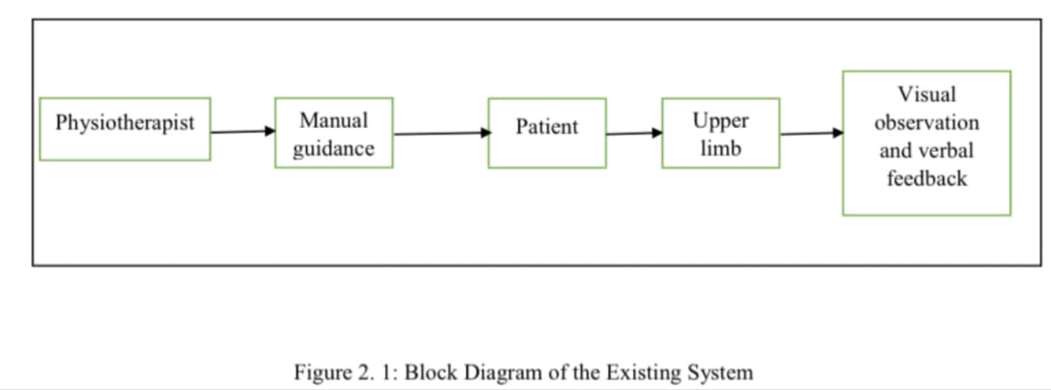
Existing Rehabilitation System
• Physiotherapist manually guides patient
• Visual observation and verbal feedback
• No sensors or motor assistance
• Subjective assessment

Slide 6
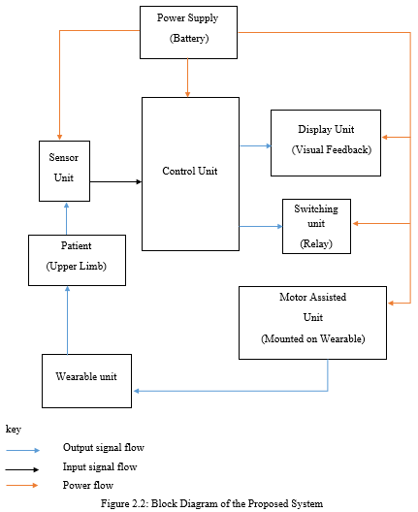

Slide 7
Proposed Rehabilitation System
• Sensor unit (IMU)
• Control unit (Microcontroller)
• Motor-assisted movement unit
• Display unit (visual feedback)
• Wearable structure
• Battery power supply

Slide 8
Table 3.1: Qualitative Observations Collected
Data Collection
No. | Observation Area | Description
1 | Patient condition | Reduced arm strength and limited movement
2 | Therapist involvement | Continuous manual assistance required
3 | Rehabilitation effort | Repetitive and physically demanding
4 | Movement accuracy | Difficult to assess without measurement tools
5 | Patient feedback | Mostly verbal and subjective
6 | Rehabilitation efficiency | Dependent on therapist availability

Slide 9
Table 3.2: Patient Clinical Condition Data
No. | Patient Category | Medical Condition | Affected Body Part | Affected Side | Estimated %
1 | Adult | Stroke | Upper limb | Right arm | 35
2 | Adult | Stroke | Upper limb | Left arm | 25
3 | Adult | Traumatic injury | Upper limb | Right arm | 15
4 | Adult | Traumatic injury | Upper limb | Left arm | 10
5 | Adult | Neurological disorder | Upper limb | Either side | 10
6 | Adult | Post-surgical injury | Upper limb | Either side | 5

Slide 10
Table 3.3: Manual Upper Limb Rehabilitation Methods
No. | Rehabilitation Method | Description | Therapist Involvement | Typical Repetitions
1 | Assisted flexion | Therapist assists arm bending | High | 10–15
2 | Assisted extension | Therapist assists arm straightening | High | 10–15
3 | Passive movement | Therapist moves arm fully | Very high | 5–10
4 | Active-assisted movement | Patient and therapist cooperate | High | 10
5 | Range of motion exercise | Joint moved within safe range | High | 5–15

Slide 11
Table 3.4: Upper Limb Range of Motion Data
No. | Joint | Movement Type | Typical Range (°) | Safe Rehabilitation Range (°)
1 | Elbow | Flexion | 0–140 | 0–120
2 | Elbow | Extension | 140–0 | 120–0
3 | Shoulder | Flexion | 0–180 | 0–90
4 | Shoulder | Extension | 180–0 | 90–0

Slide 12
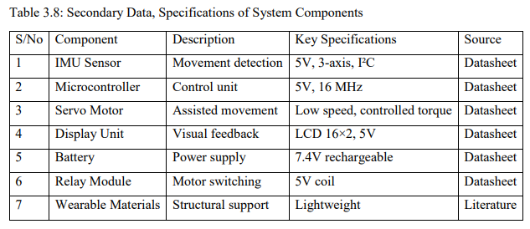
Secondary Data

Slide 13
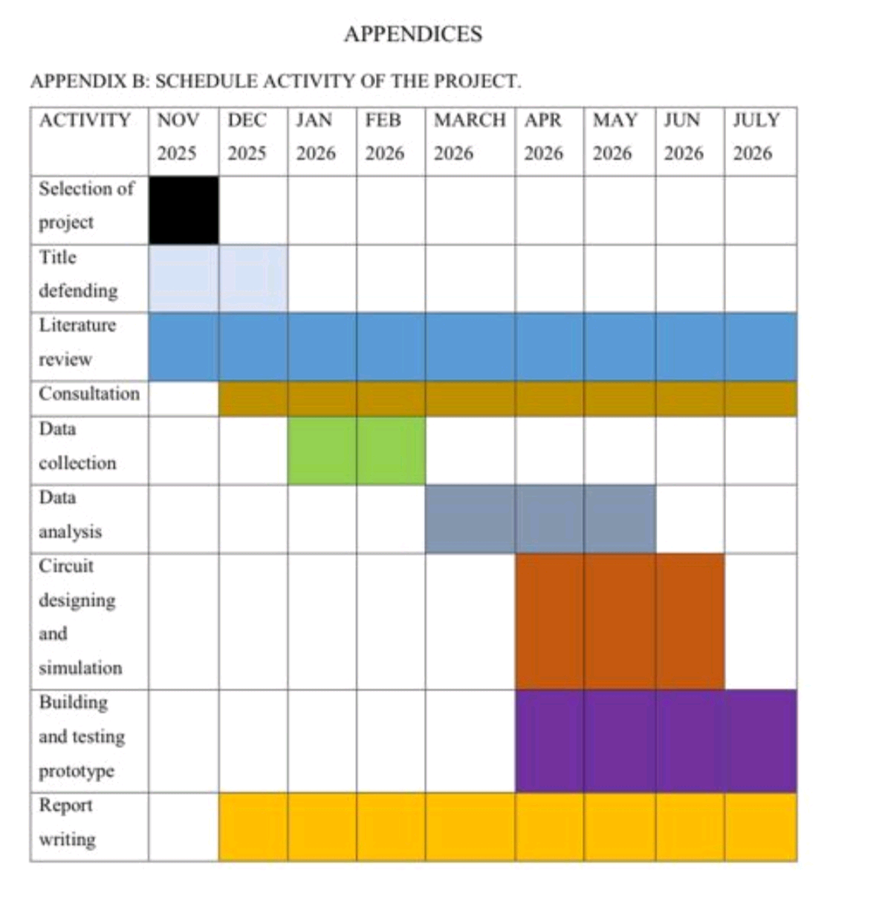

Slide 14
Budget Estimation
Total estimated cost: 315,000 TZS
Sensors, microcontroller, motor, display, battery, materials
Conclusion
Smart wearable system improves rehabilitation efficiency
Provides guided and safe upper limb movement
Reduces therapist workload
Suitable for MOI rehabilitation environment

