Slide 1

DAR ES SALAAM INSTITUTE OF TECHNOLOGY
DEPARTMENT OF ELECTRONICS AND TELECOMMUNICATION
PROJECT TITLE: AI & IOT BASED HEALTH AND DAILY NEEDS ASSISTANCE SYSTEM FOR PARALYSIS PATIENT
STUDENT’S NAMES: 1.ISMAILY RAMADHANI RAJABU - 210640720849
2.ZAINABU ALLY ALOYCE - 230647407724
CLASS: BENG 20 ETE
ACADEMIC YEAR: 2025/2026

Slide 2
BACKGROUND
Paralysis patients often cannot move or speak properly, making communication very difficult. In Tanzania, over 10% of people live with disabilities, and many patients depend fully on caregivers. Delays in expressing needs like pain or emergencies can lead to serious health problems.
Common methods like calling out, pressing buttons, or using mobile phones often do not work for patients with weak movement. Regular health monitoring is also unavailable , making it hard for caregivers and medical staff to respond quickly.
Therefore, there is a need for a smart, reliable, and low-cost system that uses AI for gesture recognition and IoT for remote monitoring, enabling patients to communicate easily and improving safety, independence, and quality of care while reducing caregiver burden.

Slide 3
PROBLEM STATEMENT
Paralysis patients face difficulties in communication and health monitoring due to limited or impaired movement. Challenges in expressing their needs and the lack of continuous monitoring of vital health parameters may lead to delayed medical attention, reduced safety, and increased dependence on caregivers.

Slide 4
MAIN OBJECTIVE
To design and develop an AI and IoT-based system that enables paralysis patients to communicate using hand gesture recognition and provides real-time health monitoring, improving patient independence, safety, and facilitating remote care.

Slide 5
SPECIFIC OBJECTIVES
I. To implement hand gesture recognition and real-time monitoring system of vital signs.
II. To implement a wireless communication system to transmit patient gestures and health data.
III. To develop an IoT platform with a local dashboard for caregivers and remote access for doctors.
IV. To test and evaluate the system’s accuracy, response time, reliability, and usability.

Slide 6
LITERATURE REVIEW
S/N | AUTHORS | YEAR | TECHNOLOGY USED | STRENGTH | WEAKNESS
1. | Gayathiri & Haziqah, | 2024 | IoT for paralysis patient healthcare (ESP32 + motion sensors) | Affordable, simple device; includes vital sign monitoring | No robust AI for gesture recognition; limited real-time response.
2. | Kishore Kanna et al., 2024 | 2024 | Assistive glove for paralysis & health info via IoT | Integrates communication and vital monitoring | Basic gesture detection, lacks AI learning to detect complex or weak gestures
3. | A.K. & U.N.T., | 2025 | IoT smart glove + sensors + SVM for gesture & health monitoring | integrates gesture recognition and health monitoring, real-time IoT data | Moderate AI accuracy (~82%); limited gesture types;

Slide 7
4. | Kalpavi C.Y. et al. | 2025 | IoT‑enabled smart gloves with sensors for gesture + health | Combines communication + health monitoring in one IoT system | Designed for military, not medical; may not suit low‑movement users
5. | Angshuman Khan et al. | 2025 | IoT‑enabled sensor glove for paralysed patients | Directly addresses communication + health monitoring; real‑time IoT transmission | Accuracy and reliability data vary)
6. | Gayathiri & Haziqah | 2024 | IoT‑based healthcare w/ gesture for paralysis | Practical, wearable, low‑cost device for communication and health | Limited published evaluation data (project report)

Slide 8
LITERATURE REVIEW CONCLUSION
Most existing systems for paralysis patients can only do one thing: either help them communicate or monitor their health. The proposed AI and IoT system is better because it uses AI to accurately recognize hand gestures for communication and monitors vital health signs in real time, sending alerts to caregivers. Therefore, it can make patients more independent, safe, and well cared for.

Slide 9
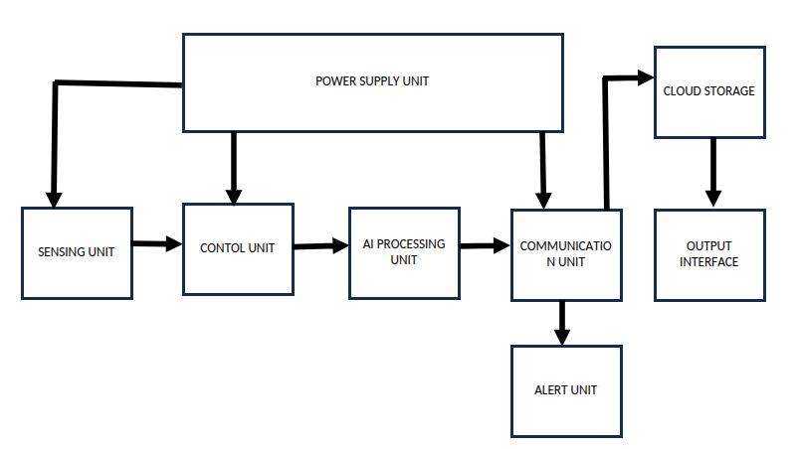
BLOCK DIAGRAM OF PROPOSED SYSTEM

Slide 10
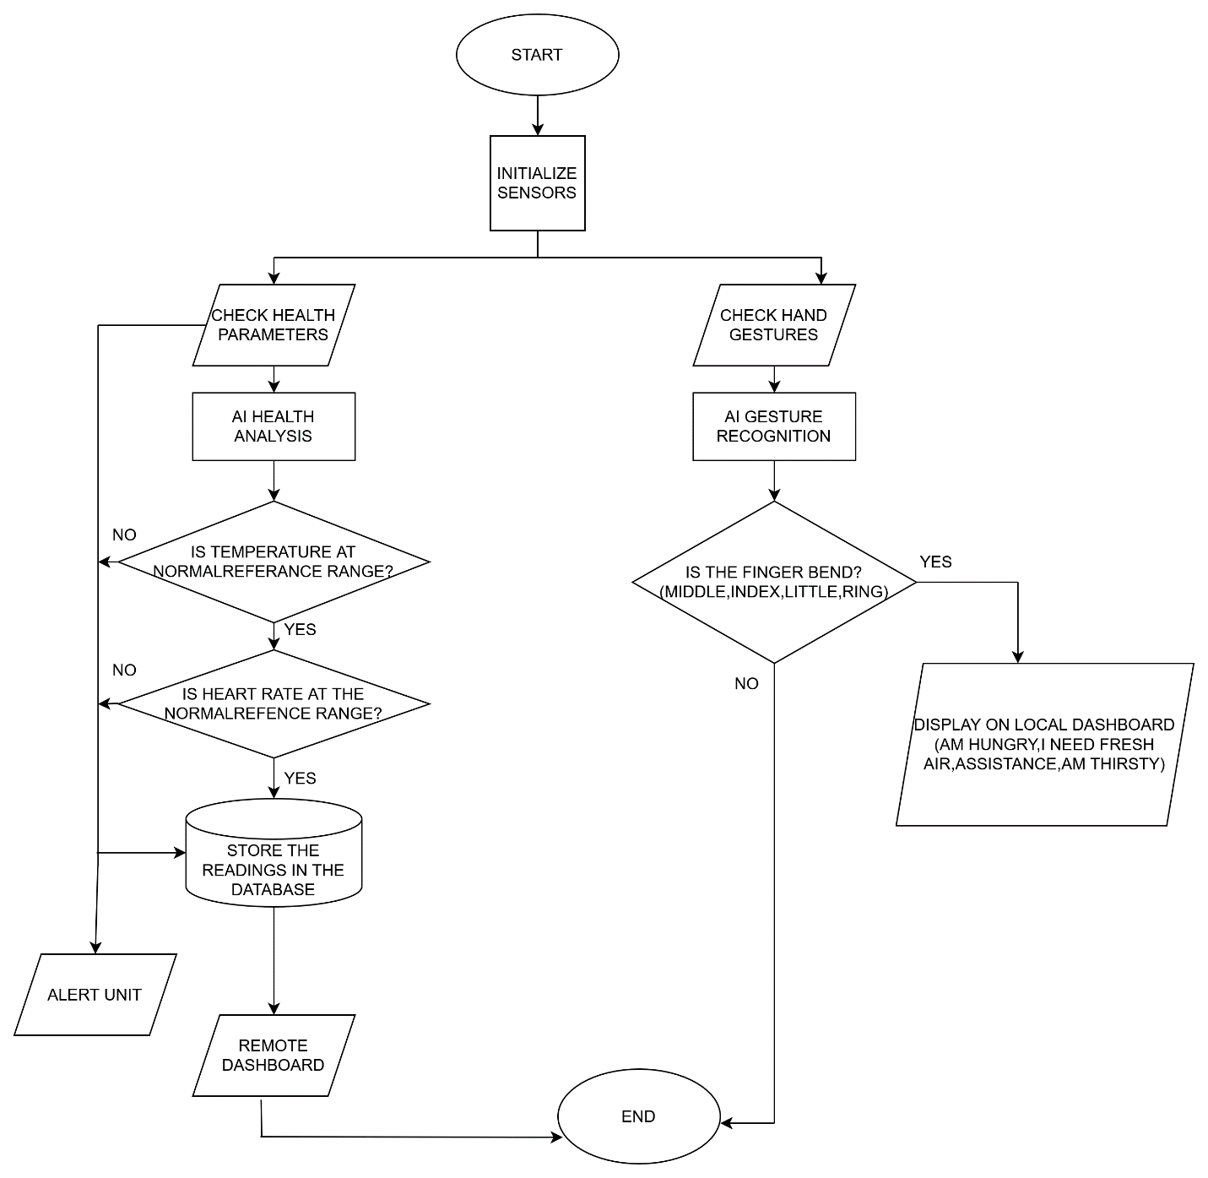
FLOW CHART OF PROPOSED SYSTEM

Slide 11
DATA COLLECTION
PRIMARY DATA COLLECTION
Primary data for this study were collected through a structured questionnaire . The survey targeted healthcare providers ,caregivers, and patients to understand the challenges faced by paralysis patients in hospitals and the need for assistive systems.

Slide 12
Doctors' Responses Summary.
Parameter | Yes | No | Percentage Yes | Percentage No
Continuous Monitoring | 5 | 0 | 100% | 0%
Emergency Alert System | 4 | 1 | 80% | 20%
AI Health Prediction | 4 | 1 | 80% | 20%
Remote IoT Monitoring | 4 | 1 | 80% | 20%

Slide 13
Continuous Health Monitoring for Paralysis Patient Response

Slide 14
Caregivers' Responses Summary.
Parameter | Yes | No | Percentage yes | Percentage No
Communication Difficulty | 8 | 2 | 80% | 20%
Need for Emergency Alert System | 9 | 1 | 90% | 10%
Technological Assistance for Daily Activities | 8 | 2 | 80% | 20%

Slide 15
Communication Difficulty for Paralysis Patient Response.

Slide 16
Summary of Patients’ Responses.
Daily Activity Assistance | Number of Responses | percentage
Feeding (Food & Drinking) | 2 | 40%
Toilet Assistance | 1 | 20%
Getting Fresh Air / Outdoor Movement | 1 | 20%
Moving/Position Changing | 1 | 20%

Slide 17
Daily Activities Assistance Response

Slide 18
SECONDARY DATA COLLECTION
Secondary data for this project was collected from research papers, journals, reports, and reliable online sources related to AI, IoT, smart gloves, and healthcare monitoring systems. These sources provided information on the challenges faced by paralysis patients, existing assistive technologies, and the use of gesture recognition and wearable sensors in healthcare.
This secondary data helped identify gaps in existing systems and guided the design of the proposed AI and IoT-based assistance system. By combining this with primary data from surveys, the project gained a complete understanding of the problem, providing a solid foundation for developing an effective system for partially paralyzed patients.

Slide 19
Power Supply Requirements for Battery-Powered System.
S/N | Components | Requirements
i. | Stable Voltage Supply | The system must receive a consistent voltage to ensure proper operation of sensors and microcontrollers. Recommended voltage range: 5 V ± 0.5 V for microcontrollers and sensors.
ii. | Backup Power Capacity: | A rechargeable battery must maintain system operation during power interruptions. Recommended backup: 7–12 hours of continuous operation.

Slide 20
Sensing Unit Requirements
S/N | Component | Requirements
i. | Body Temperature Sensor | High accuracy about ±0.5°C to detect variations in body temperature. Range: 20°C to 50°C, suitable for human body temperature monitoring. Non-invasive design, such as infrared or contact thermometers.
ii. | Heart rate sensor: | High accuracy of about ±5 bpm for heart rate. Lightweight and applicable of wearable design for continuous monitoring.
iii. | Motion Sensor: | Responsible for detecting head tilt and gesture movements’ i.e angular movements and linear acceleration. High sensitivity and accuracy to detect both intentional and accidental gestures. Low-power operation and ease to integrate wearable device.

Slide 21
Control Unit Requirements.
 | Component | Requirements
i. | Processor: | A microcontroller with sufficient memory to process multiple sensor inputs
ii. | Data Processing | Embedded algorithms to analyze sensor data, detect anomalies, and execute commands based on user input (hand gestures).
iii | . Low Power Consumption | Essential for prolonged operation.
iv. | Peripheral Support | Support for I2C, UART, SPI, and analog-to-digital conversion for sensor integration.
v. | Real-Time Operation: | Capability to perform real-time health parameter monitoring and alert generation.

Slide 22
Communication Unit Requirements.
S/N | Components | requirements
i. | Reliable Data Transmission: | The communication system should ensure stable and consistent transmission of health data and alerts without interruptions. It should support both short-range and long-range communication, depending on the caregiver's proximity and the system's location.
ii. | Real-Time Alerts: | The system must provide real-time notifications for emergency situations such as abnormal health parameters or specific user commands such as head tilt gestures. Notifications should be sent promptly to the caregiver or healthcare provider to avoid delays in assistance.
iii. | Dual Communication Capability: | The system should support both local communication (e.g., within a household or healthcare facility) and remote communication (e.g., to a caregiver located far away).

Slide 23
iv. | Data Security: | Security mechanisms should be in place to protect sensitive health data during transmission. Encryption and authentication measures should ensure data integrity and prevent unauthorized access.
v. | Low Power Consumption: | The communication system should be energy-efficient to operate seamlessly within a solar-powered setup, conserving battery life and ensuring prolonged usage.
vi. | Compatibility with Other Units: | The communication system should integrate smoothly with the control unit and the user interface to send data and alerts efficiently. It must be compatible with both the database for data storage and the web server for remote data access.

Slide 24
Display Unit Requirements.
S/N | Components | Requirements
i. | Interface | Clear and small onboard display for local data visualization. User-friendly design for displaying measured health parameters and notification messages.
ii. | Real-Time Data | Updates every second or as required, ensuring current health status is always visible.

Slide 25
Database Requirements.
S/N | Components | Requirements
i. | Data structure | It must contain tables for users, health data and messages and provide relationship between user roles.
ii. | Scalability | Ability to manage growing user data and accommodate more patients over time.
iii. | Storage | Ability to handle real-time data like health monitoring parameters and logs and store historical records for analysis and references.

Slide 26
User Interface Requirements.
S/N | Components | Requirements
i. | Interface design | Contains a dashboard showing real-time and historical data
ii. | Functions | • Display visual health parameters Option to export data for medical evaluation User authentication s
iii. | Accessibility | Simple navigation and easier to be used and adopted

Slide 27
AI Processing Unit Requirements.
S/N | Components | Requirements
i. | Gesture Recognition | Accurately detect hand and finger movements, including subtle gestures. Recognition accuracy should be ≥ 90% for reliable patient communication
ii. | Health Data Analysis | Continuously monitor vital signs: Heart Rate: 40–180 bpm (beats per minute), accuracy ±5 bpm Body Temperature: 35–42°C, accuracy ±0.5°C
iii. | Real-Time Processing | Process sensor data with minimal latency; response time should be ≤ 1 second for gesture recognition and alert generation.

Slide 28
iv. | Integration and Compatibility: | Seamless interfacing with the control unit, communication module, and user interface. Support standard data protocols (I2C, SPI, UART) for sensors and wireless modules.
v. | Adaptability and Learning: | AI models should allow continuous learning and adaptation. Accuracy improvement over time should reach ≥ 95% after model training with patient-specific gestures.

Slide 29
CONCLUSION
The questionnaires show that paralysis patients face serious communication challenges and need continuous monitoring of vital signs. Most respondents supported using gesture-based communication, real-time health monitoring, and remote access for doctors and caregivers. Secondary data from existing studies also confirms that AI and IoT technologies can effectively support these needs. Together, the findings justify developing an AI and IoT-based assistive system to improve patient safety, communication, and overall care.

