Slide 1

DAR ES SALAAM INSTITUTE OF TECHNOLOGY (DIT).
NAME OF STUDENT: MONICA JOHN NTEMI.
PROJECT TITLE: SECURED DOOR ENTRY USING
RFID TECHNOLOGY.
REGISTRATION: 210611220901.
CLASS: OD23 CST.

Slide 2
PROBLEM STATEMENT
Traditional key and password door system are insecure because keys can be duplicated and passwords can be shared easily and leading to unauthorized entry.

Slide 3
OBJECTIVES OF THE PROJECT.
To design and implement a door entry system using RFID technology
that allows only authorized users to access the door.
MAIN OBJECTIVE
❖ To design and implement a door entry system using RFID technology that allows only authorized users to access the restricted area
SPECIFIC OBJECTIVE
To enhance security by using RFID based authentication.
To automate door access control.
To reduce unauthorized entry.
To provide a user friendly and efficient system.

Slide 4
OPERATION OF EXISTING SYSTEM
A literature review is a detailed academic paper, that talks about what we already know about a topic. It include important discoveries, ideas and method related to the topic.
EXISTING SYSTEM
The existing door entry system uses traditional key and mechanical lock user insert key into the lock and turns it to open the door the system operates manually without electronic verification.

Slide 5
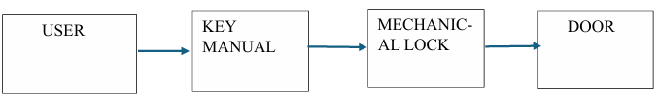
BLOCK DIAGRAM OF EXISTING SYSTEM

Slide 6
LIMITATION OF THE EXISTING SYSTEM
No record of access history.
Key can be lost and duplicated.
Difficult to manage multiple users.
No centralized control

Slide 7
PROPOSED SYSTEM
The system works by reading a unique ID from an RFID card and comparing it with ID stored in the microcontroller.

Slide 8
ADVANTAGES OF THE PROPOSED SYSTEM
  High security: RFID tags have unique IDs that are difficult to copy.
  Contactless operation: no physical touching is needed.
  Cost effective: cheaper compared to fingerprint and face recognition system.
  Reliable: not affected by dirt and sweat condition like biometric systems

Slide 9
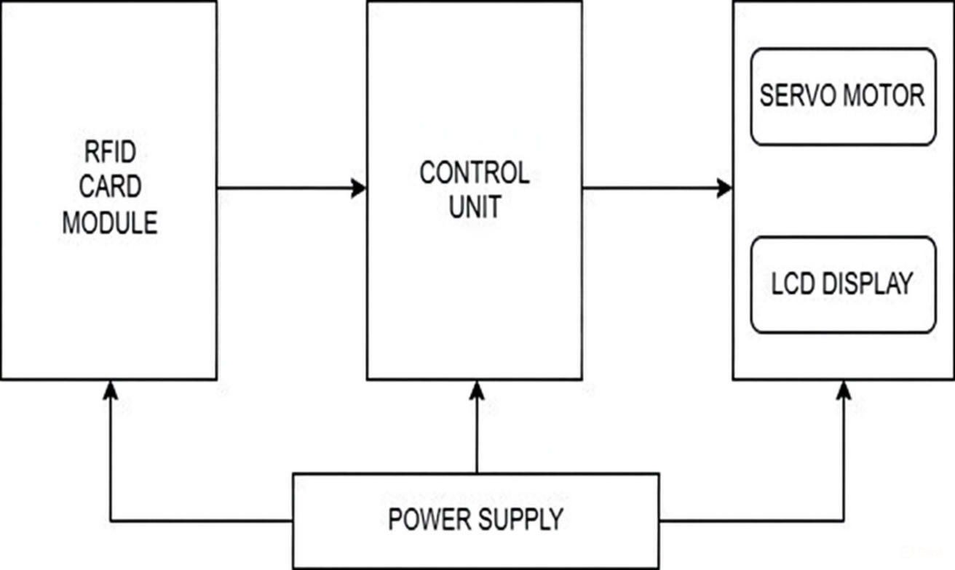
BLOCK DIAGRAM OF PROPOSED SYSTEM

