Slide 1

DAR ES SALAAM INSTITUTE OF TECHNOLOGY
PROJECT TITLE:DESIGN AND IMPLEMENTATION OF AN OXYGEN PURITY MONITORING SYSTEM IN OXYGEN CONCENTRATORS FOR PATIENT SAFETY.
MODULE:PROJECT CONCEPTUALIZATION
PROJECT TYPE: PROLEM SOLVING
CLASS :BENG22 ETE
NAME | REGISTRATION
SILVIA M. BAYYO | 220647497022
NANCY R MAIMU | 220647469088

Slide 2
BACKGROUND OF THE PROJECT
Oxygen concentrators are widely used in medical care to supply oxygen with purity levels above 90%. However, oxygen purity can fluctuate during operation, and many existing systems lack continuous real-time monitoring of purity. This makes it difficult to promptly detect performance changes, which may compromise reliable and safe delivery of medical-grade oxygen. Continuous monitoring of oxygen purity is therefore essential to ensure consistent and dependable operation.

Slide 3
PROBLEM STATEMENT
Many oxygen concentrators do not provide continuous real-time monitoring of oxygen purity, relying instead on periodic checks.
This can fail to detect sudden purity drops caused by operating conditions or component wear, leading to unsafe oxygen delivery and potential risks to patient safety.

Slide 4
OBJECTIVES
MAIN OBJECTIVE:
To design and implement a system for continuous and real-time monitoring of oxygen purity in an oxygen concentrator.

Slide 5
OBJECTIVES
SPECIFIC OBJECTIVES:
To design and implement the sensing unit.
To design and implement safety mechanism.
To develop the control unit for data processing and system management.
To design and implement power supply for all system components.
To design and implement real-Time User Feedback and Communication.
To design the system prototype and testing.

Slide 6
LITERATURE REVIEW
S.No | Author(s) | Year | Technique Used | Strengths | Weakness / Limitation
1. | Shivalinga, Jayaraj & Paul | 2024 | Air pressure sensor + Arduino for measuring flow & indirect purity in portable concentrators | Low-cost and real-time monitoring; easy to build | Indirect estimation of purity (pressure proxy) not direct O₂ sensing
2. | Ardiansyah & Sujiwa | 2025 | Silica gel filtration analysis to measure oxygen concentration changes | Practical evaluation of media effects on purity | Not a direct sensor method; purity results depend on filtering materials
3. | Santos et al. (in MDPI study) | 2025 | Pressure Swing Adsorption (PSA) parametric optimization measuring oxygen % | Empirical validation of PSA purity performance | Not a dedicated sensing technique, more operational measurement
4. | Intelligent OC closed-loop system | 2025 | MAX30100 feedback + PID control to modulate concentrator based on SpO₂ | Automated adjustment of oxygen level | Relies on blood SpO₂ (patient), not direct gas purity sensor

Slide 7
LITERATURE REVIEW
Existing Limitations:
Current existing systems mainly use standalone oxygen analysers.
Indirect oxygen purity estimation methods.
Offline or periodic oxygen purity evaluation.
Patient SpO₂–based oxygen control systems.
Proposed system:
It is to integrate real-time oxygen purity detection.
Safety alerts and user interface integrated

Slide 8
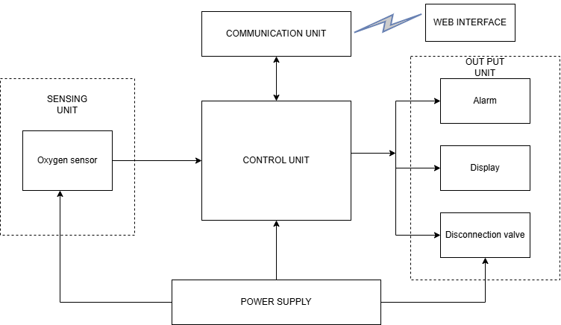
BLOCK DIAGRAM OF A PROPOSED SYSTEM

Slide 9
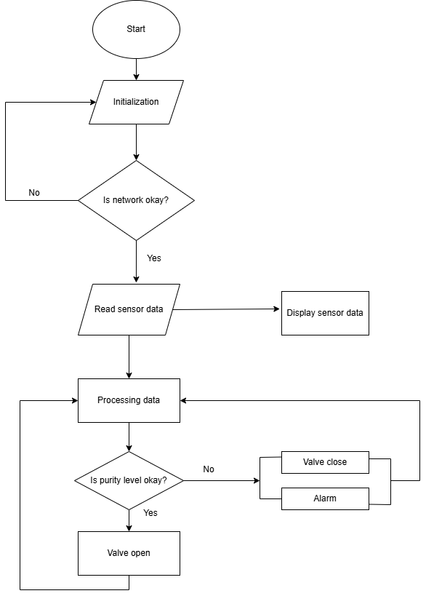
FLOW CHART

Slide 10
DATA COLLECTION
Primary data
Primary data was collected using structured questionnaires administered to medical staff and technicians to understand real-world challenges in monitoring oxygen purity and oxygen concentrator performance as well as observation.
The aim was to identify conditions under which changes in oxygen purity may go unnoticed and to determine the types of alerts and monitoring features required to enhance patient safety.

Slide 11
DATA COLLECTION
Primary Data
QN NO | Question | Response choice | Responses
1. | What is your role? | a) Technician b) Nurse c) Doctor d) Biomedical Eng. e) Other | a) 38 b) 2 c) 8 d) 46 e) 11
2. | What oxygen flow rate is commonly used? | a) 1–2 L/min b) 3–4 L/min c) 5 L/min d) Not sure | a) 14 b) 40 c) 26 d) 24
3. | Have you observed oxygen purity fluctuations during concentrator operation? | a) Yes b) No c) Not sure | a) 82 b) 8 c) 14

Slide 12
QN NO | Question | Response choice | Responses
4. | How do you normally know the oxygen purity level? | a) Display on the concentrator b) External oxygen analyzer c) During servicing d) We do not check | a) 36 b) 68 c) 19 d) 11
5. | Have you ever experienced a delay in identifying low oxygen purity levels? | a) Yes b) No | a) 82 b) 22
6. | Has delayed detection of low oxygen purity ever posed a risk to patient safety? | a) Yes, serious risk b) Yes, minor risk c) No risk observed d) Not applicable | a) 60 b) 24 c) 15 d) 6

Slide 13
QN NO | Question | Response choice | Responses
10 | Do you think continuous real-time oxygen purity monitoring is necessary for patient safety? | a) Strongly agree b) Agree c) Neutral d) Disagree | a) 83 b) 21 c) 1 d) 0
11. | Would a web-based interface for real-time oxygen purity monitoring be useful in your facility? | a) Yes b) No | a) 95 b) 10
12. | Which features would be most important in a web-based oxygen purity monitoring system? | a) Real-time oxygen purity display b) Visual and audible alerts c) Data logging and history tracking d) Remote access by clinicians/technicians | a) 93 b) 70 c) 54 d) 57

Slide 14
QN NO | Question | Response choice | Response
7. | In your opinion, can failure to detect low oxygen purity lead to critical or catastrophic patient outcomes? | a) Strongly agree b) Agree c) Neutral d) Disagree | a) 67 b) 32 c) 6 d) 0
8. | On average, how many hours per day is the oxygen concentrator used? | a) Less than 4 hours b) 4–8 hours c) 8–12 hours d) More than 12 hours | a) 21 b) 51 c) 15 d) 18
9. | Does the oxygen concentrator provide an alarm when oxygen purity falls below safe levels? | a) Yes b) No | a) 82 b) 22

Slide 15
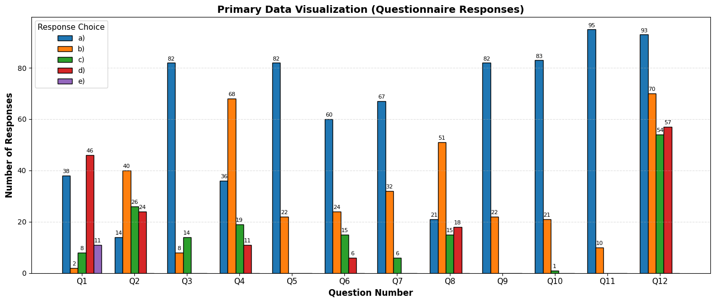
PRIMARY DATA VISUALIZATION

Slide 16
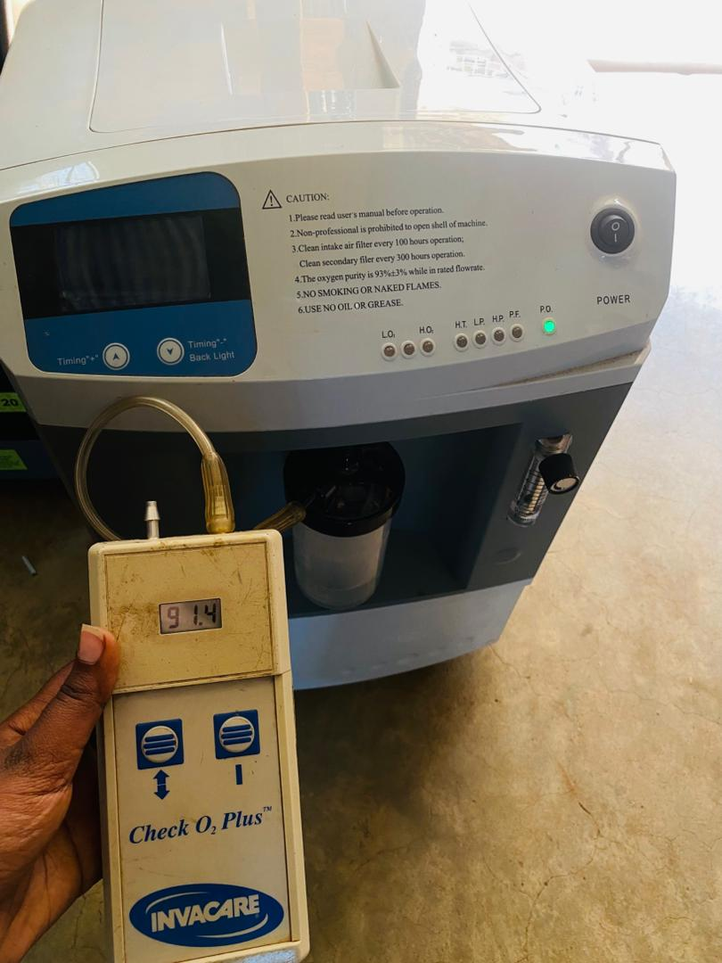
OBSERVATION

Slide 17
PRIMARY DATA
Interpretation
Approximately 50% response confirms that existing monitoring approaches are not sufficiently reliable, justifying the need for a system that continuously evaluates oxygen purity rather than relying on periodic check or assumptions.
Users value early detection of abnormal oxygen purity conditions since more than 57% of the majority supports proactive monitoring rather than reactive intervention where patient’s safety is at risk.
Lack of real time monitoring web interface has delay in monitoring oxygen purity. 90% of respondents reflect a strong belief that patient safety depends on reliable oxygen purity monitoring.

Slide 18
Conclusion
Primary data were collected through structured questionnaires to understand user needs and safety concerns related to oxygen concentrators.
Secondary data were obtained from USAID/PATH guidelines, World Bank concentrator manuals, and relevant literature to define technical and operating requirements. Overall, the collected data sufficiently supported the design of the proposed real-time oxygen purity monitoring system.

Slide 19
DATA COLLECTION
Secondary data
Data was collected through a review of documented information from recognized health and engineering authorities related to oxygen concentrator operation, safety standards, and performance requirements.
The data focused on the following system units:
Sensing unit
Control unit
Communication unit
Output unit
Dashboard/web interface
Power unit

Slide 20
OXYGEN SENSING UNIT
Parameter | Requirements | Basis for Selection
Measurement range | 21% – 100% O₂ | Medical oxygen application
Minimum acceptable purity | ≥ 90% | WHO medical oxygen standard
Accuracy | ±2% | Literature review (2019–2024)
Response time | < 15 seconds | Real-time monitoring requirement
Output type | Analog voltage | Compatibility with microcontroller
Operating temperature | 0–50°C | Hospital environment

Slide 21
CONTROL UNIT
Parameter | Requirements | Design Justification
ADC resolution | ≥ 10-bit | Accurate oxygen percentage conversion
Processing capability | ≥ 16 MHz | Real-time data processing
Operating voltage | 3.3V / 5V | Sensor compatibility
Memory | ≥ 32 KB | Program storage
Communication support | Wi-Fi capable | Remote monitoring
Power consumption | Low | Continuous operation

Slide 22
COMMUNICATION UNIT
Parameter | Requirements | Purpose
Network type | Wi-Fi (2.4 GHz) | Hospital compatibility
Data update interval | 1–5 seconds | Near real-time monitoring
Communication protocol | HTTP / MQTT | Web dashboard integration
Indoor coverage | ≥ 20 meters | Ward coverage

Slide 23
ALARM SYSTEM
Parameter | Requirements | Purpose
Warning threshold | O₂ < 90% | Safety alert
Critical threshold | O₂ ≤ 85% | Emergency condition
Alarm type | Audible + Visual | Immediate notification
Response time | < 2 seconds | Rapid detection

Slide 24
DISCONNECTION VALVE
Parameter | Requirements | Purpose
Valve type | Solenoid valve | Automatic shut-off
Operation mode | Normally open | Allows oxygen flow when safe
Operating voltage | 12V DC | Reliable control
Pressure rating | ≥ 30 psi | Compatible with concentrator output

Slide 25
POWER SUPPLY
Parameter | Requirements | Purpose
Input | 220V AC | Hospital standard
Output | 5V DC / 12V DC | Component supply
Regulation tolerance | ±5% | Stable operation
Protection | Overcurrent & surge protection | Safety

Slide 26
DISPLAY UNIT
Parameter | Requirements | Technical Justification
Display Type | 16x2 or 20x4 Alphanumeric LCD | Sufficient to display oxygen % and status messages
Operating Voltage | 5V DC | Compatible with microcontroller
Current Consumption | ≤ 20 mA (without backlight) | Low power requirement
Interface Mode | 4-bit or I2C Serial Interface | Reduces number of MCU pins used
Operating Temperature | 0°C – 50°C | Suitable for indoor clinical settings
Response Time | < 1 second refresh | Real-time monitoring requirement
Displayed Parameters | Oxygen % value + Status (Normal/Warning/Critical) | User-friendly monitoring

Slide 27
Conclusion
The findings from the secondary data were used to derive technical requirements and form the basis for the system design.

Slide 28
REFERENCES
[1]Ajmal, M. B., Usama, M., & Bangash, Z. (2025). Experimental evaluation of a portable oxygen concentrator based on pressure swing adsorption. Separation and Purification Technology, 125886.
[2]Baranwal, J., et al. (2022). Electrochemical sensors and their applications: A review. Sensors, 22(9), 363. https://doi.org/10.3390/s2209363
[3]Farhi, L., Rehman, R., & Khan, M. A. (2021). Adaptive learning controller and monitoring of oxygen saturation for COVID-19 patients. In Proceedings of the International Conference on Biomedical Engineering Systems and Technologies.
[4]PATH & USAID. (2022). Standard operating procedure for oxygen concentrators. PATH.
[5]Sobel, J. A., et al. (2023). Descriptive characteristics of continuous oximetry monitoring in clinical settings. Journal of Clinical Monitoring and Computing.

