Slide 1

DAR ES SALAAM INSTITUTE OF TECHNOLOGY
DEPARTMENT OF ELECTRICAL ENGINEERING
BACHELOR OF ELECTRICAL IN ELECTRICAL ENGINEERING
NTA LEVEL 8
PROJECT TITLE: DESIGN OF AN AUTOMATICGREENHOUSE MONITORING AND CONTROL SYSTEM FOR TOMATO PRODUCTION AT DUNDA FARM(BAGAMOYO).
PROJECT TYPE: PROBLEM SOLVING
STUDENT NAME: JACKLINE J, BONIFAS
REGISTRATION NO: 230343461168
CLASS: BENG22EE
ACADEMIC YEAR: 2025/2026
SUPERVISOR’S NAME: MR. NASSORO S, NASSORO

Slide 2
PROBLEM STATEMENT
Tomato production is highly dependent on environmental factors such as temperature and humidity, which directly influence crop growth and yield. Tomato production in Bagamoyo is highly affected by uncontrolled environmental conditions, particularly high temperatures and excessive humidity resulting from the coastal climate. Traditional open-field farming and manually managed greenhouses expose tomato crops to heat stress, humidity-related diseases, poor fruit quality, and inconsistent yields.
This project aims to address these challenges by designing of an Automatic greenhouse monitoring and control system tailored to tomato production in Dunda farm (Bagamoyo), enabling real-time monitoring of temperature and humidity, automated control, and improved productivity.

Slide 3
OBJECTIVES OF THE PROJECT
MAIN OBJECTIVE
The main objective of the project is to design an automatic greenhouse monitoring and controlling environmental conditions to enhance tomato growth and improve agricultural activities.
SPECIFIC OBJECTIVE
To determine requirements of the design of an automatic greenhouse monitoring and control.
To design a system for monitoring environmental conditions.
To build and test the prototype for designed system.

Slide 4
SIGNIFICANCE OF THE PROJECT
Improves tomato production at dunda farm by maintaining environmental conditions
Help in timely detection of abnormal greenhouse conditions, hence prevent crop stress and losses
Reduce manual labor and human error
Support sustainable agriculture practices and long term productivity

Slide 5
METHODOLOGY OF THE PROJECT
Literature Review
Data Collection
Data Analysis
Circuit design and simulation
Prototype Development
Testing and Evaluation
Documentation and Report Writing

Slide 6
LITERATURE REVIEW
  Existing system.
The existing system monitors environmental conditions manually. The controlling is done based on farmer’s experience.

Slide 7
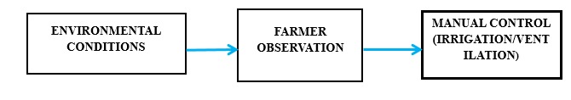
LITERATURE REVIEW
BLOCK DIAGRAM OF THE EXISTING SYSTEM

Slide 8
LITERATURE REVIEW
PROPOSED SYSTEM
The proposed system is microcontroller-based system. Sensors continuously measure environmental conditions in real time, sensor data is processed by the microcontroller. The mist sprayer activates automatically when temperature exceeds the set value and water pump is turned ON when soil moisture is low. The system maintains optimal greenhouse conditions with minimal human intervention.

Slide 9
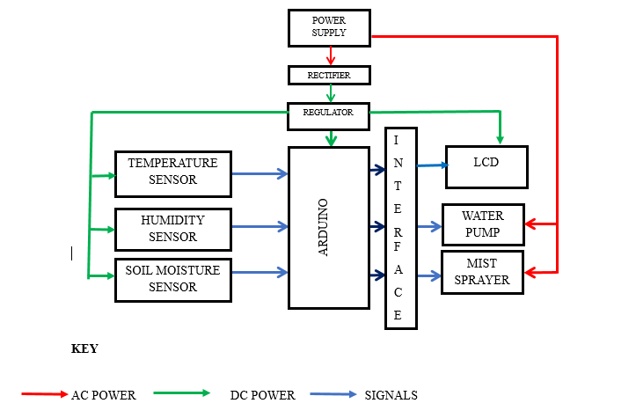
LITERATURE REVIEW
PROPOSED SYSTEM BLOCK DIAGRAM

Slide 10
DATA COLLECTION
Primary data
time | Temp(°C) outside | Temp(°C) inside | RH(%) | Soil temp | Ventilation status
06:00 | 24 | 26 | 85 | 25 | OFF
09:00 | 28 | 32 | 78 | 27 | Vent open
12:00 | 32 | 38 | 65 | 30 | Fan ON
15:00 | 33 | 40 | 60 | 31 | Fan ON
18:00 | 29 | 34 | 70 | 29 | Fan OFF
21:00 | 26 | 30 | 80 | 27 | OFF

Slide 11
DATA COLLECTION
Optimal tomato growing condition
Parameter | Recommended Range
Temperature (Day) | 22 °C – 26 °C
Temperature (Night) | 16 °C – 20 °C
Relative Humidity | 60% – 70%
Soil Moisture | 18 °C – 24 °C

Slide 12
DATA COLLECTION
Control thresholds used in the system
Cooling ON: Temperature ≥ 26 °C
Cooling OFF: Temperature ≤ 22 °C
Irrigation ON: Soil moisture ≥ 25 °C
Irrigation OFF: Soil moisture ≤ 18 °C

