Slide 1

TITLE: DESIGNING AND FABRICATION OF A SMART HOME DRINKING WATER FOR PURIFICATION AND QUALITY ANALYSIS SYSTEM
PROJECT TYPE: DESIGN
STUDENT’S NAME: MATUKU, N ZACHARIA
REG NO: 230444423283
SUPERVISOR NAME: PROF. PATRICK D. NSIMAMA

Slide 2
Statement of the problem
Many households face challenges in maintaining safe drinking water due to the lack of real-time monitoring of water quality parameters (Ali et al.,2020 ), dependence on manual or outdated water purification methods, inability to detect contamination early, high costs and delays associated with laboratory water testing and limited awareness daily water quality conditions
Therefore, there is a critical need to design and implement a smart home drinking water purification and quality analysis system that not only purifies but also provides real-time analysis of key quality parameters such as turbidity and salinity (EPA,2020).

Slide 3
Statement of the problem
The current project work aims to design and fabricate a smart home drinking water purification and quality analysis system.

Slide 4
objectives
General objective
To design and fabricate a smart home drinking water purification and quality analysis system.
Specific objectives
To design a smart home drinking water purification and quality analysis system.
To fabricate the smart home drinking water purification and quality analysis system.
To test the smart home drinking water purification and quality analysis system

Slide 5
Significance of the Project
Improves public health by ensuring safe drinking water
Enable real-time water quality monitoring
Reduce costs compared to bottled water
Uses smart technology for better control
Helps to reduce plastic waste
Can be used in both rural and urban areas

Slide 6
Materials and Methods
The purification module will be designed using a combination of mechanical (e.g., sediment filters) and chemical (e.g., activated carbon) methods (Singh et al.,2021)
The chosen components will be assembled on hardware board following the system schematic and sensors will be integrated and calibrated to detect water quality parameters ( Kumar & Ran,2019 ).

Slide 7
Materials and Methods
Various water samples ( tap, well, and bottled water ) will be collected.
The fabricated system will be used to measure and log water quality data such as pH, turbidity, and salinity.
The reading will be compared with WHO standards to evaluate system performance
The system will be enclosed in a protective casing for home use and connected to a display unit for real-time feedback (Patel & sharm,2020).

Slide 8
Data collection and Analysis
Sensor's readings( digital output from pH, turbidity, and salinity sensors) will be collected using microcontroller.
The data will be logged and analyzed using software such as Excell or python for trend analysis.
Cross-validation will be done by comparing sensor output with standard laboratory methods like pH meters and turbidity meters.

Slide 9
Laboratory Work Location
The lab work will be conducted in the Physics laboratory for assembling and calibrating the system.
Water sample testing and quality verification will be done in the environmental/analytical chemistry laboratory

Slide 10
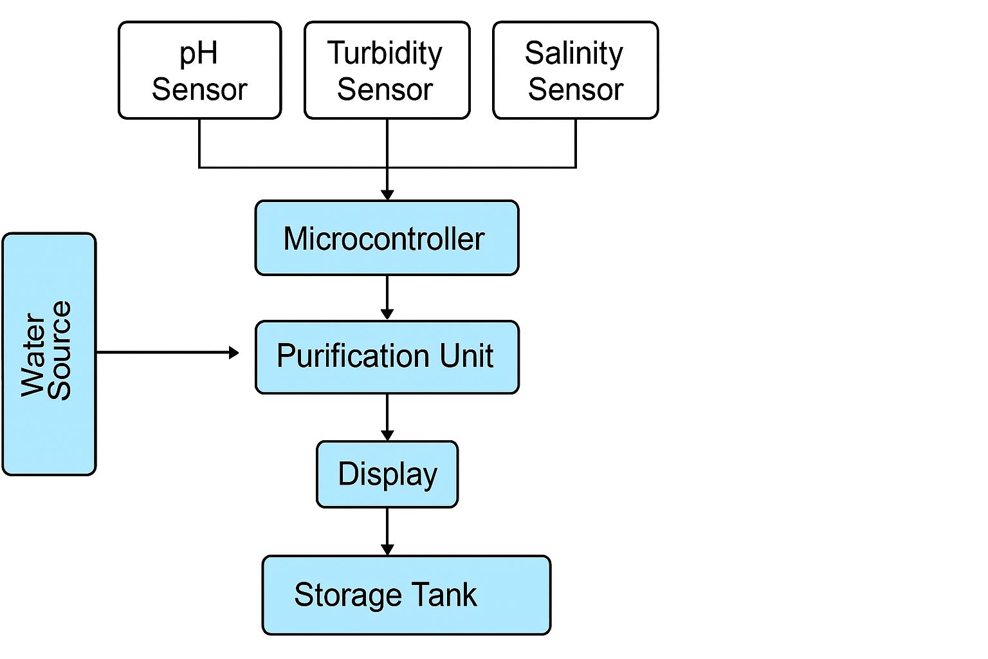
Block Diagram of the System

